Slide 1
SOFTWARE ARCHITECTURE AND DESIGN
SENG 307
Architecture Styles and Patterns

Slide 2
Architecture Styles and Patterns
An Architecture style describes the macrostructure of a system.
Architecture styles allow you to use existing and well-known structures that support certain architectural characteristics (also known as nonfunctional quality attributes, system quality attributes, or “-ilities”).
Architecture patterns describe reusable structural building block patterns that can be used within each of the architecture styles to solve a particular problem.
Architecture patterns differ from design patterns in that an architecture pattern impacts the structural aspect of a system, whereas a design pattern impacts how the source code is designed.

Slide 3
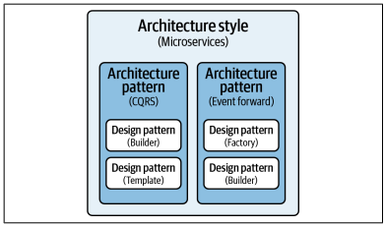
Architecture styles can be composed of architectural patterns, which in turn can be composed of design patterns
Design patterns and architecture patterns are typically combined to form a complete solution
Architecture styles can also be combined when building software solutions to form a complete solution – Hybrid architecture

Slide 4
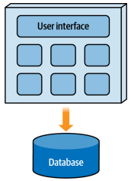
Architecture Classification - Monolithic Architectures
generally much simpler than distributed ones, and as such are easier to design and implement.
fairly inexpensive from an overall cost standpoint
can be developed and deployed much more quickly than distributed ones
scalability, fault tolerance, and elasticity are its weak points.
A fatal error (such as an out-of-memory condition) in a monolithic architecture causes all of the functionality to fail.
Notes:
mean time to recovery (MTTR) and mean time to start (MTTS) are usually measured in minutes, meaning that once a failure does occur, it takes a long time for the application to start back up.

Slide 5
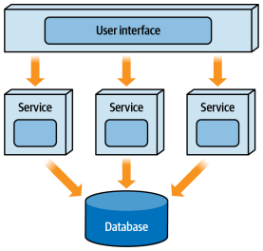
Architecture Classification - Distributed Architectures
consist of multiple deployment units that work together to perform some sort of cohesive business function
Advantages include scalability, elasticity, fault tolerance, and in some cases, performance
MTTD and MTTR are much smaller than with a monolithic application, measured usually in seconds (and in some cases milliseconds) rather than minutes in Monolithic.
Distributed architectures are plagued with what is known as the fallacies of distributed computing, a set of eight things we believe to be true about networks and distributed computing, but are in fact false
Notes:
Distributed architectures are well suited for supporting high levels of fault tolerance. If one service fails, in many cases other services can continue to service requests as if no fault happened. Services that do fail can recover very quickly—so quickly that at times an end user sometimes doesn’t even know the service had a fatal error.
Because application func‐ tionality is divided into separately deployed units of software, it is easier to locate and apply a change, the testing scope is reduced to only the service that is impacted, and deployment risk is sig‐ nificantly reduced because only the service impacted is typically deployed.

Slide 6
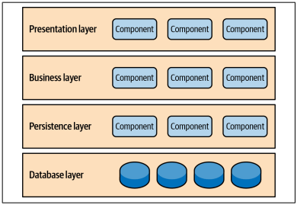
Layered Architecture

Slide 7
Layered Architecture: Description
The most common architectural style is the layered architecture
otherwise known as the n-tier architecture
Components within the layered architecture style are organized into horizontal layers, each performing a specific role within the application
Although the number of layers may vary, most layered architectures consist of four standard layers: presentation, business, persistence, and database
One of the powerful features of the layered architecture style is the separation of concerns among components. Components within a specific layer deal only with logic that pertains to that layer

Slide 8
Layered Architecture: Key Concepts
In this architecture style, layers can be either open or closed.
A closed layer means that as a request moves from layer to layer, it must go through the layer right below it to get to the next layer below that one.
This might result in certain bottlenecks like speed, efficiency, accuracy, etc. To avoid this scenario the layer of isolation concept is used
The layers of isolation concept means that changes made in one layer of the architecture generally don’t impact or affect components in other layers
Each layer is independent of the other layers, thereby having little or no knowledge of the inner workings of other layers in the architecture
tightly coupled and brittle architectures that are very difficult to test, maintain, and deploy are issues that may arise in the layered architecture

Slide 9
Layered Architecture: When to consider
Complexity: It helps manage and reduce complexity by breaking down the system into smaller, manageable parts. Each layer has a well-defined purpose, which makes it easier to understand and maintain the system.
Modularity: If you want your system to be modular, with clearly defined and independent components, this can help. Each layer can be developed and maintained independently, making it easier to replace or upgrade specific parts of the system without affecting others.
Scalability: This can be scaled horizontally by adding more instances of a particular layer (e.g., adding more web servers). This can help you handle increased load or demand without having to rework the entire system.
Flexibility: When you anticipate that different parts of the system might change at different rates or be developed by different teams. Teams can work on their respective layers without interfering with others, as long as the interfaces between layers are well-defined.
Security: Separating concerns into layers can enhance security. For example, sensitive data can be isolated in a secure layer, and access to it can be controlled and monitored.
Maintainability: Make it easier to maintain and update a system over time. You can make changes or improvements to one layer without affecting the others, reducing the risk of introducing bugs or unintended side effects.

Slide 10
Challenges and Considerations
Limited Scalability: Because of its monolithic nature, applications built using this architecture style are generally difficult to scale
Tight Coupling: One of the main concerns in layered architecture is the potential for tight coupling between layers. Tight coupling can make it challenging to make changes to one layer without affecting others.
Performance Overhead: Passing data and control between layers can introduce performance overhead, especially in systems where high throughput or low latency is critical
Rigidity: Layered architectures can become rigid over time, making it difficult to adapt to changing requirements or new technologies. Changes to one layer may necessitate changes in multiple other layers, leading to complex and time-consuming maintenance.
Not fault-tolerant: A fatal crash in any part of the application brings down the entire application functionality

Slide 11
Microkernel Architecture
Also Known as a “plug-in architecture”
Flexible and extensible architecture that allows a developer to easily add additional functionality and features to an existing application in the form of extensions, or “plug-ins,” without impacting the core functionality of the system
Application logic is divided between independent plug-in modules and the basic core system, providing extensibility, flexibility, and isolation of application features and custom processing logic
The microkernel architecture style consists of two types of architecture components: a core system and plug-in modules
The functionality in the core system can then be extended through the use of separate plug-in modules.

Slide 12
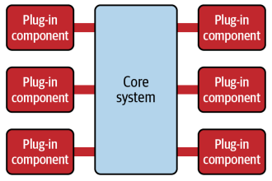
Microkernel Architecture
.

Slide 13
Microkernel Architecture Concepts
Plug-in modules are standalone, independent components that contain specialized processing, additional features, adapter logic, or custom code that is meant to enhance or extend the core system to provide additional business capabilities
Generally, plug-in modules should be independent of other plug-in modules and not be dependent on other plug-ins to function.
It’s also important in this architecture style to keep communication between plug-ins to a minimum to avoid confusing dependency issues.
The core system needs to know which plug-in modules are available and how to get to them. One common way of implementing this is through a plug-in registry.
The registry contains information about each plug-in module, including its name, contract details, and remote access protocol details (depending on how the plug-in is connected to the core system)

Slide 14
Microkernel Architecture Application
A classic example of the microkernel architecture is the Eclipse IDE. Downloading the basic Eclipse product provides you with little more than a fancy editor.
However, once you start adding plug-ins, it becomes a highly customizable and useful product for software development.
Internet browsers are another common example using the microkernel architecture: viewers and other plug-ins add additional capabilities that are not otherwise found in the basic browser (the core system).

Slide 15
When to Consider This Style
The microkernel architecture style is good to consider as a starting point for a product-based application or custom application that will have planned extensions.
A good choice for products where you will be releasing additional features over time or you want control over which users get which features
A good choice for applications or products that have multiple configurations based on a particular client environment or deployment model
As with the layered architecture style, the microkernel architecture style is relatively simple and cost-effective and is a good choice if you have a tight budget and time constraints.

Slide 16
Challenges and Considerations
All requests must go through the core system, regardless of whether the plug-ins are remote or point-to-point invocations.
Because of this, the core system acts as the main bottleneck to this architecture and is not well suited for highly scalable and elastic systems.
Similarly, overall fault tolerance is not good in this architecture style, again due to the need for the core system as an entry point
while the microkernel architectural pattern offers advantages in terms of modularity and extensibility, it also introduces complexity and potential performance overhead due to its reliance on message passing and distributed components
If you find that most of your changes are within the core system and you are not leveraging the power of plug-ins to contain additional functionality, this is likely not a good architecture match

Slide 17
Event-Driven Architecture
Event-driven software architecture is a design pattern that structures a software system around the generation and handling of events.
Events are occurrences or notifications of interest within a system, such as user actions, sensor readings, or messages from external sources.
In an event-driven architecture, components communicate primarily through events, enabling loose coupling, scalability, and responsiveness
Event-driven architecture is an architecture style that relies on asynchronous processing using highly decoupled event processors that trigger events and correspondingly respond to events happening in the system.
Usually consists of the following architectural components: an event processor, an initiative event, a processing event, and an event channel.

Slide 18
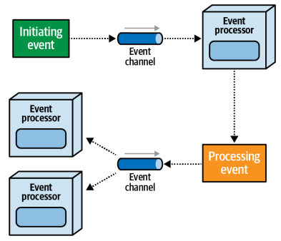
Event-Driven Architecture

Slide 19
Event-Driven Architecture Components
An initiating event usually comes from outside the main system and kicks off some sort of asynchronous workflow or process. Examples of initiating events are placing an order, buying some Apple stock, bidding on a particular item in an auction, filing an insurance claim for an accident, and so on
An event processor (service) is the main deployment unit in event-driven architecture. It can vary in granularity from a single-purpose function (such as validating an order) to a large, complex process (such as executing or settling a financial trade). Event processors can trigger asynchronous events, and respond to asynchronous events being triggered.
A processing event (derived event) is generated when the state of some service changes and that service advertises to the rest of the system what that state change was. The relationship between an initiating event and a processing event is 1:M
The event channel is the physical messaging artifact (such as a queue) that is used to store triggered events and deliver those triggered events to a service that responds to those events.

Slide 20
Advantages of Event-Driven Architecture
Loose Coupling: Event-driven systems promote loose coupling between components. Event sources and consumers do not need to have direct knowledge of each other. This makes the system more modular and easier to maintain.
Scalability: Event-driven architectures can scale horizontally by adding more event consumers or processors to handle increased event loads. This scalability is essential for handling fluctuating workloads or sudden bursts of activity.
Responsiveness: Event-driven systems are highly responsive to events as they occur. Components can react immediately to relevant events, allowing real-time processing and quick feedback to users.
Flexibility: New event consumers can be added or existing ones modified without affecting the source of events. This flexibility facilitates system evolution and adaptability.
Integration: Event-driven architecture is well-suited for integrating various systems and components, both within and outside an organization. Events can serve as the integration points between different services or microservices.

Slide 21
Challenges and Considerations
Complexity: Event-driven systems can become complex to manage, especially as the number of events and consumers grows. Proper event naming, versioning, and documentation are essential.
Event Ordering: Maintaining the order of events can be challenging, especially in distributed systems. Ensuring the correct sequence of events is critical for data consistency.
Error Handling: Handling errors and exceptions that occur during event processing requires careful consideration. Implementing proper error-handling strategies is essential to maintain system reliability.
Monitoring and Debugging: Debugging and monitoring event-driven systems can be more challenging than traditional systems, as events can propagate asynchronously through the system. Robust logging and monitoring tools are crucial.
Complex Event Processing (CEP): In some cases, event-driven architectures may require complex event processing techniques to analyze and respond to patterns of events in real-time.

Slide 22
Client-Server Architecture
In a client–server architecture, the functionality of the system is organized into services, with each service delivered from a separate server.
Clients are users of these services and access servers to make use of them.
Client components send requests to the server, which processes them and responds back.
When a server accepts a request from a client, it opens a connection with the client over a specific protocol.
Servers can be stateful or stateless. A stateful server can receive multiple requests from clients. It maintains a record of requests from the client, and this record is called a ‘session’.

Slide 23
Model–View–Controller (MVC) Architecture

Slide 24
Hybrid architecture styles are common in the real world because not every architecture style can solve every business problem.

